Slide 1
ATAI
Advanced Technique of Artificial Intelligence
ATAI
ChongqingUniversity _{AdvancedTechniqueof}
of Technology Artificial Intelligence
Chongqing University of
Technology
Chongqing University ^{ATAI}
_{of Technology} Advanced Techniqueof
Artificial Intelligence
Chongqing University of Technology
Chongqing University of Technology
Beyond Graph :Convolution Multimodal Recommendation with topology-aware MLPS
Code : https://github.com/jessicahuang0163/TMLP
—— AAAI’2025
2024.1.09 • ChongQing
Reported by YaoYao Zhang
1

Slide 2
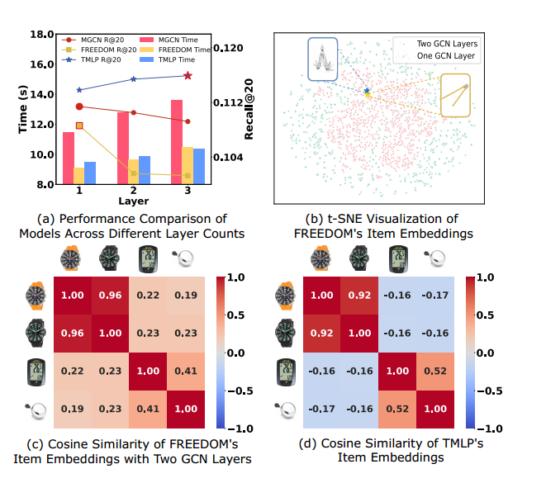
ATAI
Advanced Technique of Artificial Intelligence
ATAI
ChongqingUniversity _{AdvancedTechniqueof}
of Technology Artificial Intelligence
Chongqing University of
Technology
Chongqing University ^{ATAI}
_{of Technology} Advanced Techniqueof
Artificial Intelligence
Chongqing University of Technology
Chongqing University of Technology
Motivation
Existing multimodal recommendation systems that rely on Graph Convolutional Networks (GCNs) are limited in their performance when dealing with complex, high-dimensional multimodal data due to the inherent over-smoothing issue of GCNs.

Slide 3
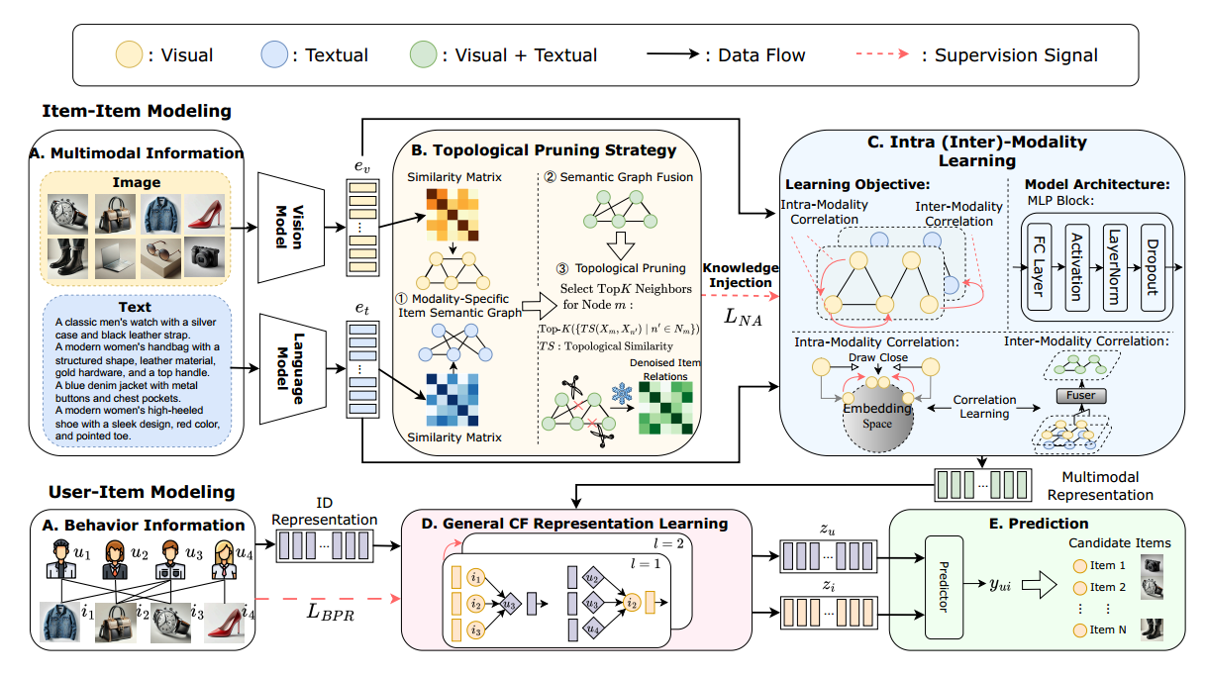
ATAI
Advanced Technique of Artificial Intelligence
ATAI
ChongqingUniversity _{AdvancedTechniqueof}
of Technology Artificial Intelligence
Chongqing University of
Technology
Chongqing University ^{ATAI}
_{of Technology} Advanced Techniqueof
Artificial Intelligence
Overview
Chongqing University of Technology
Chongqing University of Technology

Slide 4
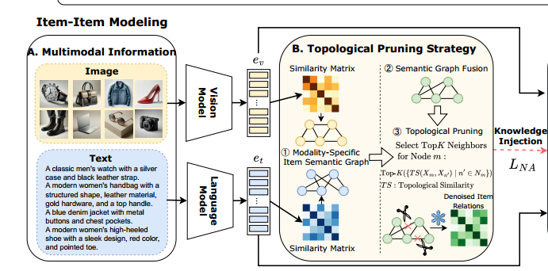
ATAI
Advanced Technique of Artificial Intelligence
ATAI
ChongqingUniversity _{AdvancedTechniqueof}
of Technology Artificial Intelligence
Chongqing University of
Technology
Chongqing University ^{ATAI}
_{of Technology} Advanced Techniqueof
Artificial Intelligence
Method
Chongqing University of Technology
Chongqing University of Technology

Slide 5
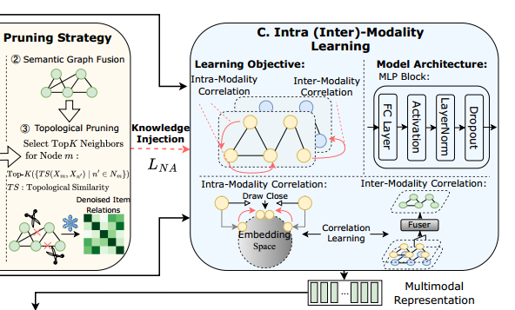
ATAI
Advanced Technique of Artificial Intelligence
ATAI
ChongqingUniversity _{AdvancedTechniqueof}
of Technology Artificial Intelligence
Chongqing University of
Technology
Chongqing University ^{ATAI}
_{of Technology} Advanced Techniqueof
Artificial Intelligence
Method
Chongqing University of Technology
Chongqing University of Technology
Notes:
(2)对一个用户所属的所有群组进行处理，让用户所属的每个群组乘以一个权重再相加得到

Slide 6
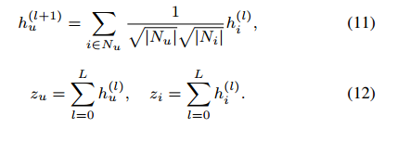
ATAI
Advanced Technique of Artificial Intelligence
ATAI
ChongqingUniversity _{AdvancedTechniqueof}
of Technology Artificial Intelligence
Chongqing University of
Technology
Chongqing University ^{ATAI}
_{of Technology} Advanced Techniqueof
Artificial Intelligence
Chongqing University of Technology
Chongqing University of Technology
Method

Slide 7
ATAI
Advanced Technique of Artificial Intelligence
ATAI
ChongqingUniversity _{AdvancedTechniqueof}
of Technology Artificial Intelligence
Chongqing University of
Technology
Chongqing University ^{ATAI}
_{of Technology} Advanced Techniqueof
Artificial Intelligence
Chongqing University of Technology
Chongqing University of Technology
Experiments

Slide 8
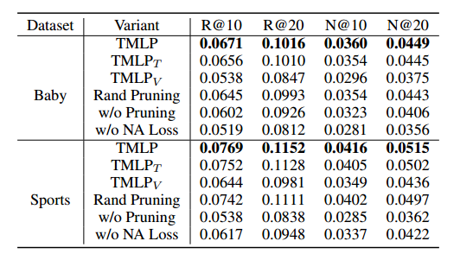
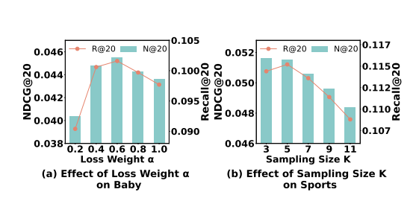
ATAI
Advanced Technique of Artificial Intelligence
ATAI
ChongqingUniversity _{AdvancedTechniqueof}
of Technology Artificial Intelligence
Chongqing University of
Technology
Chongqing University ^{ATAI}
_{of Technology} Advanced Techniqueof
Artificial Intelligence
Experiments
Chongqing University of Technology
Chongqing University of Technology

Slide 9
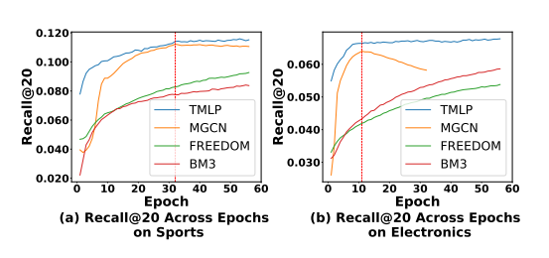
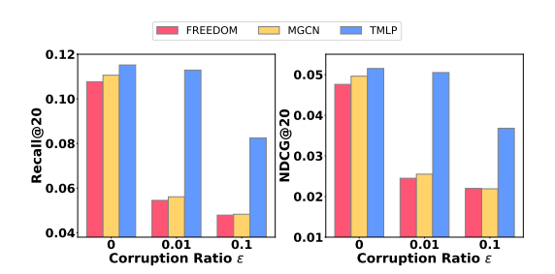
ATAI
Advanced Technique of Artificial Intelligence
ATAI
ChongqingUniversity _{AdvancedTechniqueof}
of Technology Artificial Intelligence
Chongqing University of
Technology
Chongqing University ^{ATAI}
_{of Technology} Advanced Techniqueof
Artificial Intelligence
Experiments
Chongqing University of Technology
Chongqing University of Technology

Slide 10
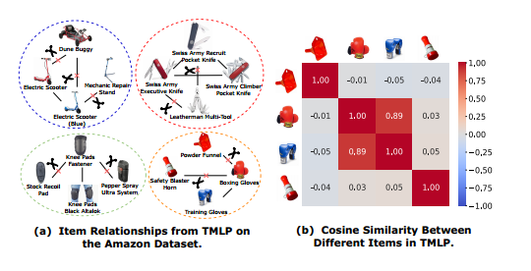
ATAI
Advanced Technique of Artificial Intelligence
ATAI
ChongqingUniversity _{AdvancedTechniqueof}
of Technology Artificial Intelligence
Chongqing University of
Technology
Chongqing University ^{ATAI}
_{of Technology} Advanced Techniqueof
Artificial Intelligence
Chongqing University of Technology
Chongqing University of Technology
Experiments

Slide 11
ATAI
Advanced Technique of Artificial Intelligence
ATAI
ChongqingUniversity _{AdvancedTechniqueof}
of Technology Artificial Intelligence
Chongqing University of
Technology
Chongqing University ^{ATAI}
_{of Technology} Advanced Techniqueof
Artificial Intelligence
Chongqing University of Technology
Chongqing University of Technology
Thanks!

